Slide 1
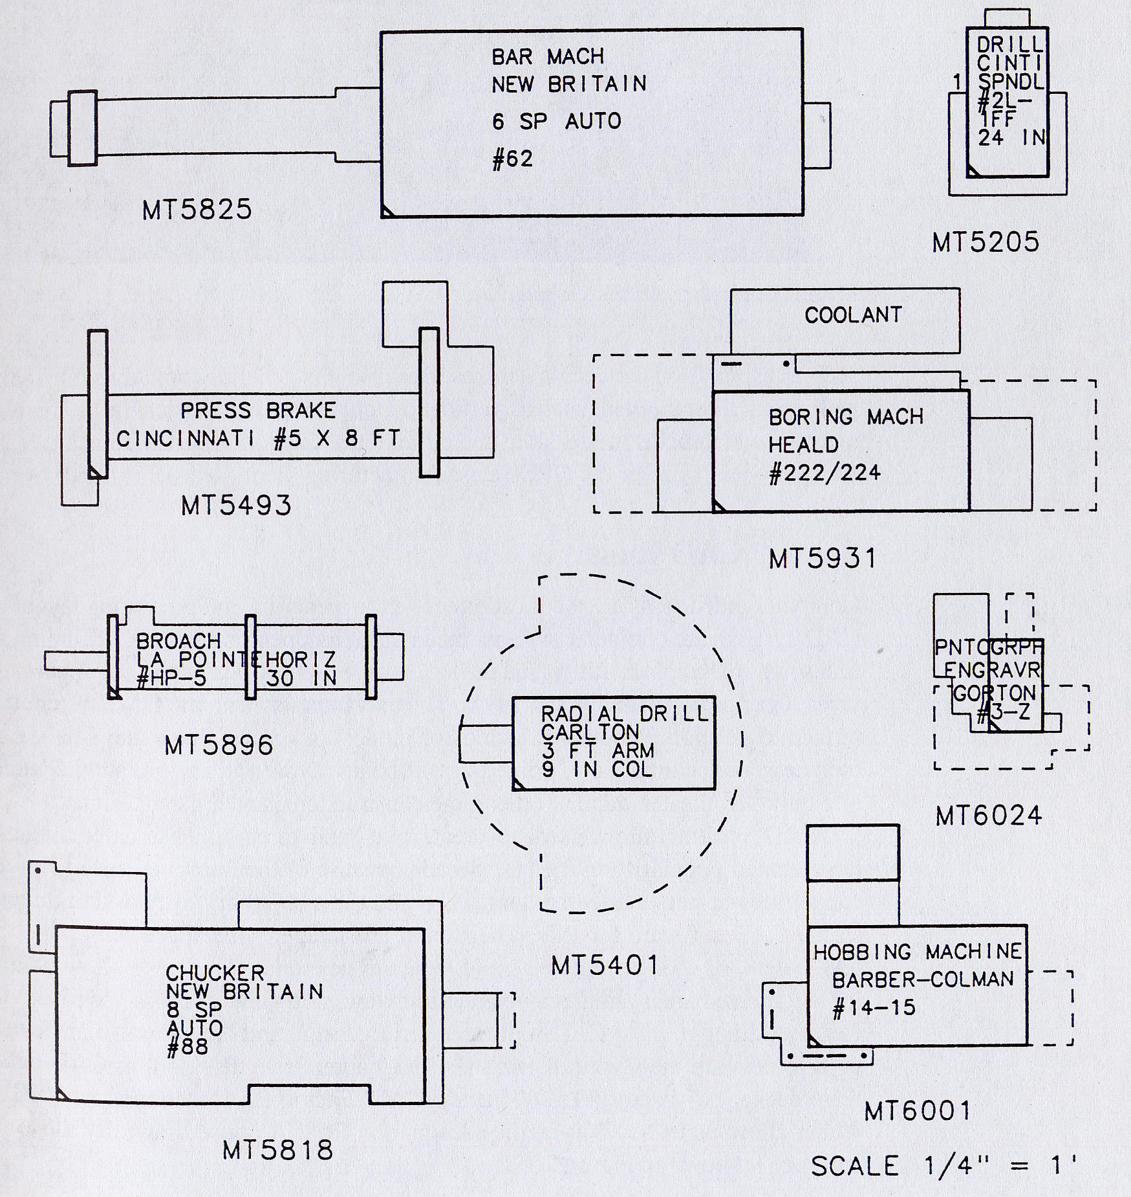
Templates

Slide 2
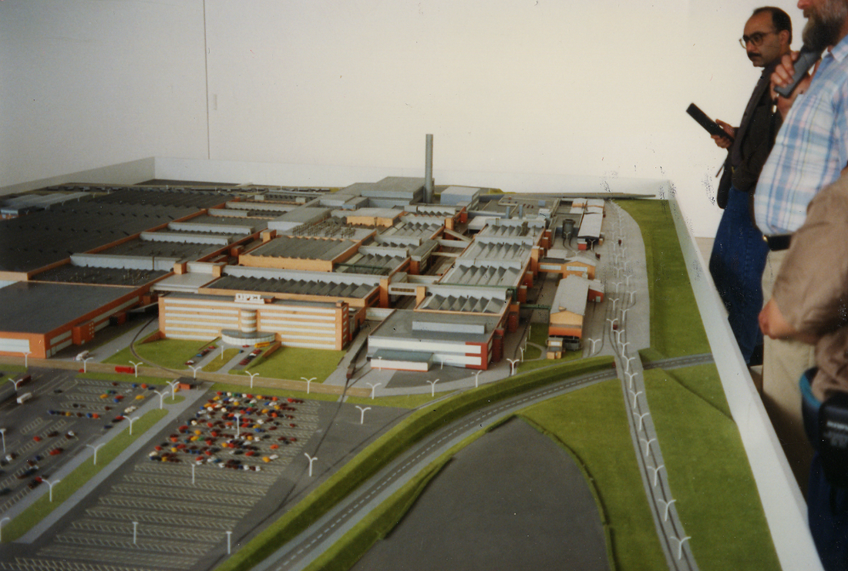
Three-dimensional physical model

Slide 3
CAD drawing

Slide 4
Steps For Data Development And Generation
Obtaining basic data
Extracting relevant data
Generate data in required format
Sharing preliminary data and obtaining feedback
Documenting Data

Slide 5
Data Generation – Case Study

Slide 6
Part Routing (Cont)

Slide 7
Part routing info matrix

Slide 8
Flow matrix

Slide 9
Machine relationship matrix

Slide 10
Machine dimensions

